Slide 1

Getting to grips with unity – building a basic pong game
A workshop by Leif Kemp
Twitter - @sirslyder

Slide 2
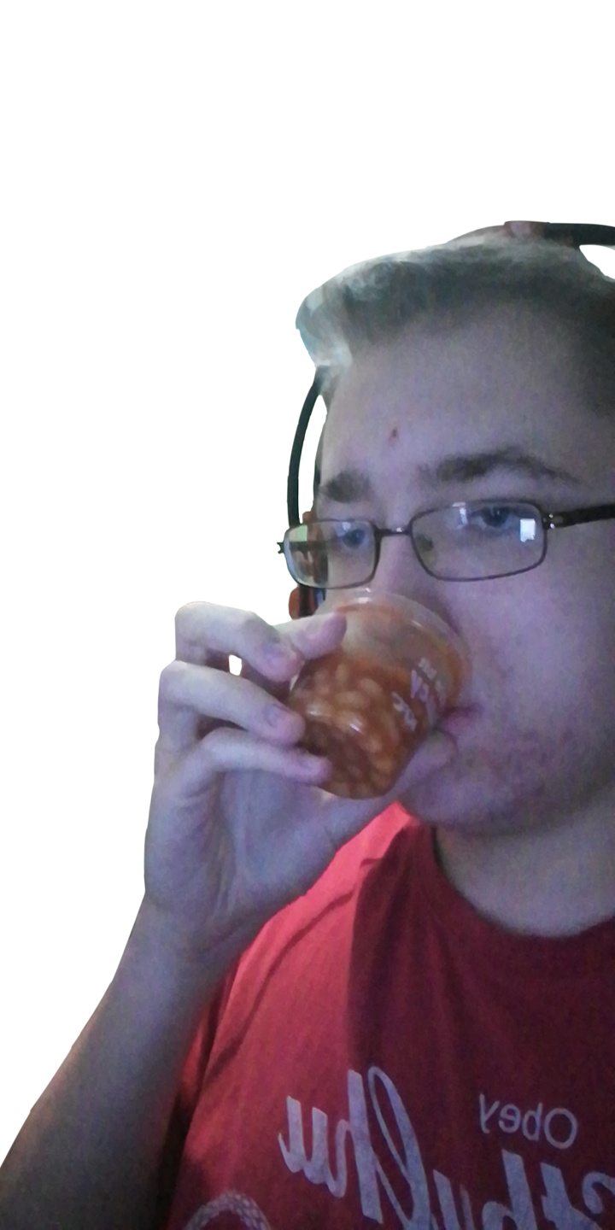
Prerequisites:
Unity 2019.1.8 installed (that’s the version the sample project is running on)
You’ll need to install the project I’m going to use at:
https://github.com/SirSlyder/GameDevWorkshop
To use these files, create a new project in Unity and then unpack and drag the files into the Assets folder of the project.

Slide 3
Contents
Part 1 – Setting the Scene
Part 2 – Player Input
2A – Mouse Input
2B – Keyboard Input
Part 3 – The Ball
Part 4 – The AI Paddle
Part 5 – Tweaks/Quality of Life Improvements

Slide 4
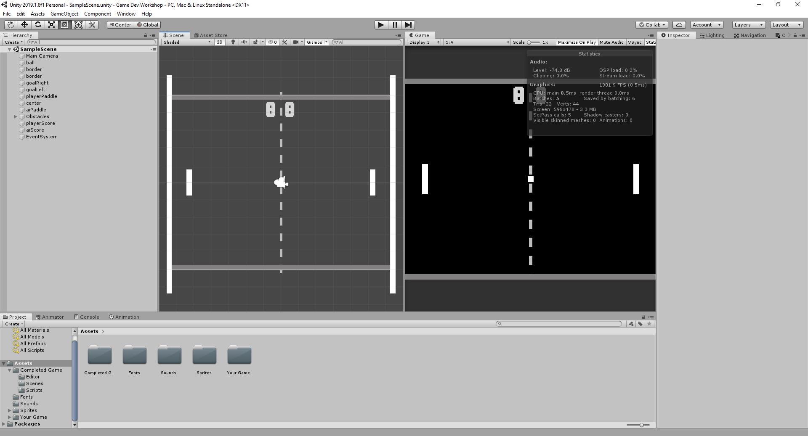
Part 1 – Setting the Scene
The provided project should come with:
A folder labelled “Completed Game”
A folder labelled “Your Game”
A few other folders for sounds, textures, fonts etc.
Open up the “Scenes” folder in the “Your Game” folder and you’ll see a file named SampleScene, which contains a basic layout for a pong game, 2 paddles, a ball in the middle, and the borders. The majority of the objects have all been tagged aswell.
All of the basic components have been added to the scene (Box Colliders, Rigidbodies etc.) for you, and I’ll run through what they do and what you can do with them.

Slide 5
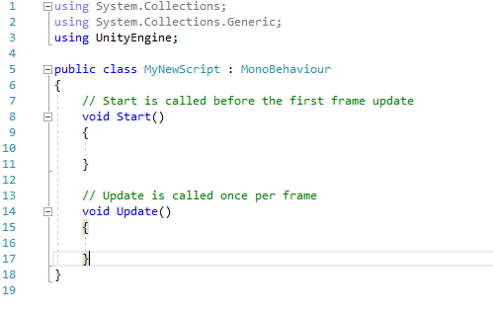
Part 1 – Setting The Scene Coding
Scripts in Unity primarily use C#, with the main programs being MonoDevelop or Visual Studio for programming.
Creating a script automatically adds 2 functions, the Start() function and the Update() function, Start() is called when the game is first launched and Update() happens once per frame. There is another important function named Awake() which is typically called before Start() does.

Slide 6
Part 2 - Player Input
Naturally, we’re going to need the player’s paddle to move up and down, if we didn’t, it wouldn’t be much of a game, would it?
In this game, we’re going to be controlling the paddle in 2 ways:
Using the mouse
Using the keyboard

Slide 7
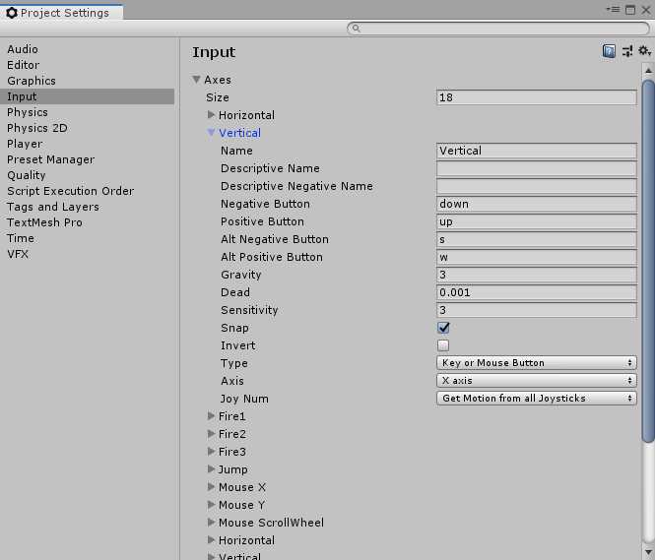
Part 2 – Player Input The Project Settings Tab
The Project Settings tab contains many useful sections to help you manage your game, the one we’re mainly going to use is the Input tab. You can find the Project Settings tab in the Edit dropdown menu in Unity.
As you can see, the Vertical Button is composed of 2 sets of 2 inputs, a positive and negative input (W & S, Up Arrow & Down Arrow), have a look at the other buttons to see how they’re set up.
At the very bottom of that image, you can see another button named “Vertical”, which is the controller set-up for vertical input.

Slide 8
Part 2A – Player Input Using the mouse
The main values we’ll need to take here is the Mouse Position and the Mouse Position relative to the world, we need to use Input.mousePosition to find the mouse’s position on the screen, and then Camera.ScreenToWorldPoint to find the relative point in the world.
Once we’ve found the relative position, we can set the y-position of the paddle to the y-position of that vector, allowing the paddle to move with the mouse.

Slide 9

Part 2A – Sample Code
This code should go in the Update() function as you need to refer to the mouse’s position each frame.
NOTE: You can’t edit just the y component of a vector on its own (example, paddle.position.y = worldPos.y), you have to create a new vector in this case and reference all 3 components, but in this case, the x component remains the same.

Slide 10
Part 2B – Player Input Using the keyboard
There are many ways to register keyboard input in Unity, using specific keys or assignable buttons.
Input.GetKey can take variables as an input and these variables can be changed during runtime (an example is rebinding your controls in the game) whereas buttons cannot, the player can only rebind them at the start-up screen for the game (assuming the default start-up screen is enabled)
Buttons have a positive and a negative axis, which can be beneficial for reducing the amount of code you have, using Input.GetAxis or Input.GetAxisRaw
Input.GetAxis outputs values that range between -1 and 1 and is primarily used for a joystick/controller, where there are multiple states the joystick can be in, whereas Input.GetAxisRaw only outputs -1, 0 and 1 regardless of state.

Slide 11
Part 2B – Sample Code
For this one, you’ll need to declare a variable in the script, I named mine playerPaddleSpeed. Don’t place it in the Update() function or you won’t be able to edit it from the Inspector, place it outside of the function.
This line goes in the Update() function:
I’m using Time.deltaTime for smoothing out movement, otherwise it would look janky, going up 5 units per frame with no movement in between, you can use other methods to smooth out the movement, such as interpolating, using Vector2.MoveTowards.
The button named “Vertical” is pre-made when you create your Unity project, and you can see what buttons are assigned to it by going into the Input tab in the Project Settings window, there is also a second Vertical button as mentioned previously which refers to joystick input, so technically you’ve also just added controller support too! Yay!

Slide 12
Part 3 – The Ball
As you’ve seen from testing the sample scene, the ball just fell to the ground and didn’t do anything. First thing’s first, we need to disable the ball’s gravity. Simply go to the Rigidbody2D component in the ball and set the gravity to 0.
After that, we need to give it a script to give it a little push towards one of the paddles. To do this, we need to pick a random number to determine the side to send the ball towards, then apply a force in a certain direction to move it. We can use either AddForce or set the velocity of the ball to do this.
We also want to add a random amount of vertical movement to the ball as well when we launch it from the centre, or else it’d just be a back and forth between 2 stationary paddles.

Slide 13
Part 3 – Sample Code
The sideToPick value is set to be either -1 or 1. Do note that Random.Range for integers has an exclusive max value but Random.Range for decimals has an inclusive max value.
(the speedModifier variable here is optional, just in case you want to make your ball move a bit faster/slower)

Slide 14
Part 3 - Scoring
In the scene, there are 2 light grey rectangles at the sides, these are the goals. We need to add a check for the ball to see whether or not it has hit one of those goals. To do this we’re going to use OnCollisionEnter2D() and the “Goal” tag the goals have.
OnCollisionEnter2D does as it says on the tin, it is called when the ball hits something. It takes a Collision2D for the parameter and you’ll need to check that it has hit a goal and which goal it has hit.
We also need 2 integer values to represent the score that the player has and the score that the AI paddle has, which we will then increment depending on which goal the ball has hit. And then once the ball has hit the goal, reset it’s position and velocity and send it towards the side who scored.
We also need to let the player know what the scores actually are, to do this, create 2 TextMesh variables representing the Player’s score and the AI’s score and assign the 2 text meshes (playerScore and aiScore) to them, then in the Update() function for that script, set the text of those meshes to the scores of the player and AI.

Slide 15


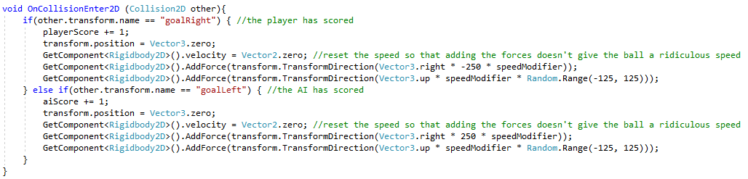

Part 3 – Scoring Sample Code

Slide 16

Part 3 – The Ball’s Physics
Now, you may have noticed that when the ball hits the top or bottom of the screen, it just slides across the edge, we don’t want this, it needs to bounce off of it. This is where Physics Materials come in. To create a physics material, simply right click, go to Create, and click Physics Material 2D.
You’re going to want the friction set to 0 and the bounciness set to 1, this means that the ball will completely bounce off the top and bottom of the screen and not lose any speed.

Slide 17
Part 4 – The AI Paddle
This part seems easy enough, right? All we have to do is look at the ball’s position and set the AI’s y position to that of the ball’s y position. Seems easy enough.

Slide 18
Part 4 – The AI Paddle
Andddd you’ve made the game impossible. Because the AI is now moving perfectly in sync with the ball and will thus never miss.
Instead we have to use a different form of movement, namely Vector2.MoveTowards or Vector3.MoveTowards.

Slide 19
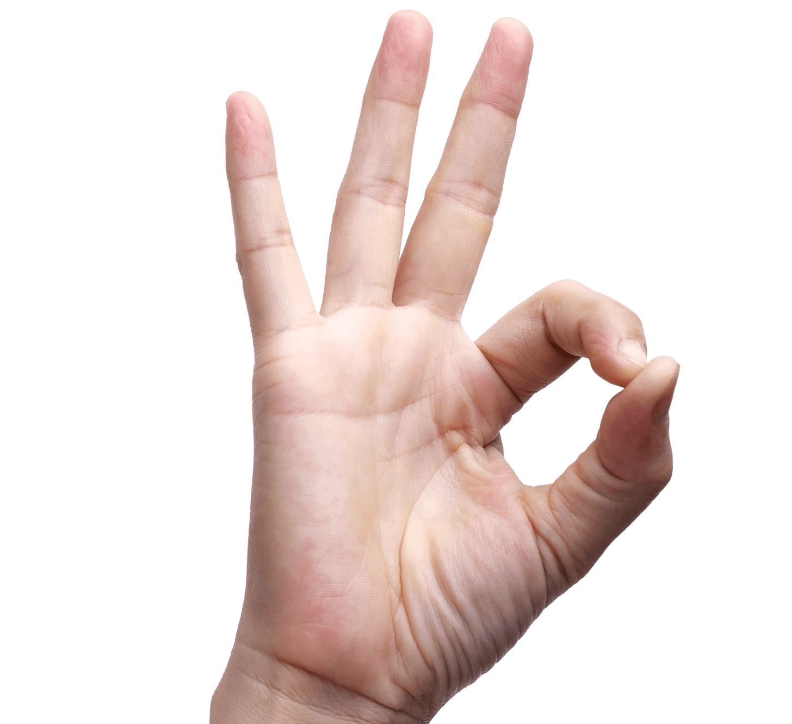
Part 5 – Improvements
That’s about it gameplay wise! While you could call this a completed project, there’s a few more things you could do.
Probably the biggest one is better feedback, primarily with sound, another is changing the logic of the ball’s bouncing physics to suit Pong’s gameplay.
The main things we’ll be covering here are:
Sound
Adjusting the ball’s physics
Switching between input types

Slide 20
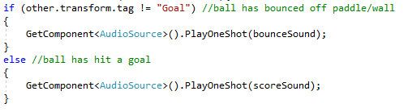
Part 5 – Improvements Sound
This is a fairly simple one, just add an AudioSource component to the ball and create two AudioClip variables in the ball’s script, name them something along the lines of bounceSound and scoreSound.
Assign some sounds to these variables (I’ve provided a few, but you can use your own)
In the OnCollisionEnter2D function in the ball’s script, simply add these lines of code:
Note: PlayOneShot is better for overlapping sounds, such as multiple bounces happening in a short time, as it doesn’t cause the sound to abruptly end.

Slide 21
Part 5 – Improvements Adjusting the ball’s physics
In Pong, when the ball bounces off of the paddle, the vertical velocity is relative to the point on the paddle that it hits.
In our current game, this is not the case, it just bounces off the paddle. We don’t want this.
So what we need to do is figure out the distance the ball is from the centre of the paddle, reset the y-velocity and apply a force to it depending on how far/close it is.

Slide 22
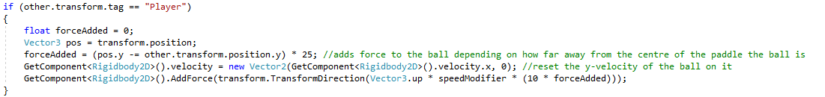
Part 5 – Ball Physics Sample Code

Slide 23
Part 5 – Improvements Switching between inputs
As I said before, you can use either mouse or keyboard/joystick to control the paddle, but one issue presented here is if we integrate both at the same time but not properly, the keyboard input won’t work and the paddle will just jiggle around, trying to move up or down but being bound to the mouse’s position.
So what we can do is disable mouse input when the mouse isn’t moving, which allows the paddle to move.
The way I did this is to have a Vector2 variable for the mouse’s previous position, then comparing it to the current position, and if they are equal, the mouse isn’t moving and we can enable keyboard input.

Slide 24
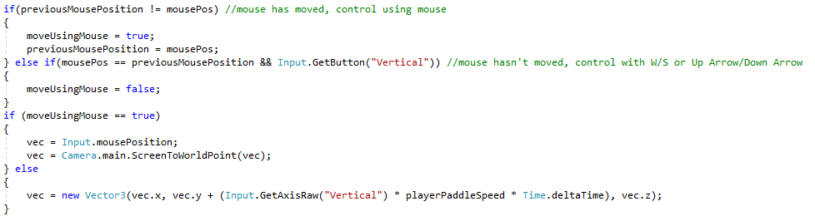
Part 5 – Switching Inputs Sample Code

Slide 25
And that’s pretty much all I have to say
If you have any suggestions for improving your projects, let me know and I can try and figure out a way to implement it.
If not, that’s all I have to say really. Enjoy your new pong game!

